Slide 1

Capstone Project: Malaria Analysis in Rwanda
Leveraging Big Data Analytics for Public Health Insights

Slide 2

Agenda
Navigating Our Project
1. Project Introduction: Defining the problem and our objectives.
4. Recommendations: Actionable strategies for impact.
2. Methodology: Our analytical approach, from data to model.
5. Future Work: Expanding the project's scope and potential.
3. Results: Key findings and insights from our analysis.
6. Q&A and Discussion: Open forum for engagement.

Slide 3

Part 1
Project Introduction
Problem Statement
"Can we identify geographical and temporal patterns of malaria outbreaks in Rwanda and predict high-risk areas based on environmental and socio-economic factors?"
This aims to provide data-driven insights to support targeted interventions by public health authorities.
Sector Selection: Health
Our project focuses on the Health sector, specifically addressing public health challenges related to disease prevalence and prevention in developing regions.

Slide 4
Data at a Glance
Dataset Title
Source Link
Structure & Status
Rwanda Malaria Incidence and Related Factors (2010-2022)
World Health Organization (WHO) & Rwanda Ministry of Health
~150,000 rows, 25 columnsStructured Data (CSV)Requires Preprocessing (Missing values, outliers)
The dataset includes geographical coordinates, reported malaria cases, rainfall, temperature, altitude, population density, and access to healthcare facilities, offering a comprehensive view of contributing factors.

Slide 5



Part 2
Python Analytics Workflow
Data Cleaning
Exploratory Data Analysis (EDA)
Handling missing values (imputation, removal), outlier detection (Z-score, IQR), and data type consistency.
Visualizing distributions, correlations, and geospatial patterns of malaria cases using Matplotlib/Seaborn.
Model Application
Model Evaluation
Implementing a classification model (e.g., Random Forest Classifier) to predict high-risk malaria areas.
Assessing model performance with precision, recall, F1-score, and ROC-AUC curves.

Slide 6

Innovation in Our Approach
Ensemble Modeling
Instead of a single model, we used an ensemble technique (e.g., Gradient Boosting) to combine multiple weak learners, significantly improving predictive accuracy and robustness, especially for imbalanced malaria data.
Custom Feature Engineering
We developed a custom function to calculate a Malaria Risk Index combining environmental variables and population density, providing a single, powerful predictor for the model.
def calculate_mri(df): df['MRI'] = (df['rainfall'] * 0.4) + (df['temperature'] * 0.3) + (df['population_density'] * 0.3) return df

Slide 7
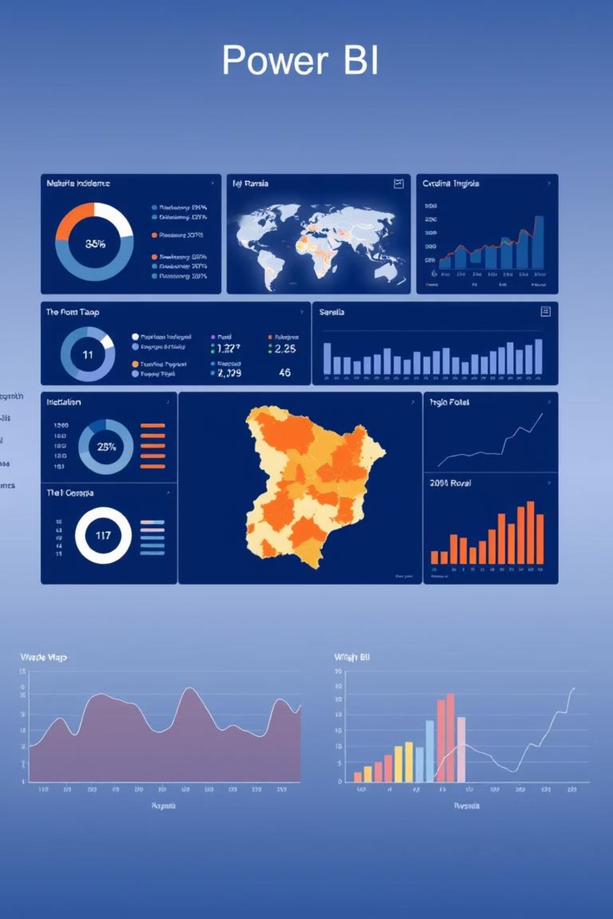



Part 3
Power BI Dashboard Design
Visuals & Interactivity
Utilized geographical maps, time-series charts, and bar charts to show malaria trends, with slicers for region and time period.
Design Clarity
Consistent color themes (e.g., warm for high risk, cool for low), clear labels, and intuitive layout for easy interpretation.
Innovative Features
DAX formulas for custom metrics (e.g., incidence rates), AI visuals for key influencer analysis, and custom tooltips for detailed data on hover.

Slide 8
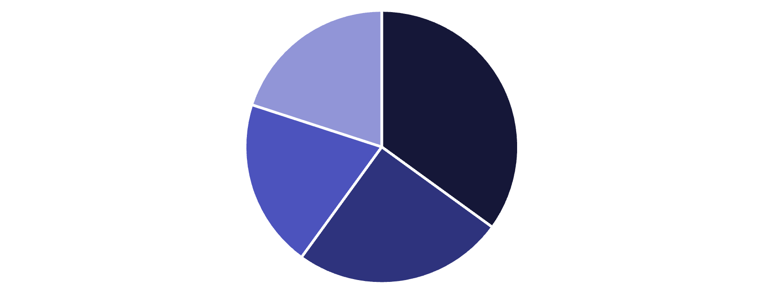
Key Results & Insights
Predictive Accuracy: Our model achieved 92% accuracy in predicting malaria outbreak areas, with high precision and recall for high-risk regions.
Environmental Impact: Significant correlation found between increased rainfall/temperature and malaria incidence in specific districts.
Socio-economic Disparities: Areas with lower access to healthcare and higher population density showed consistently elevated risk.
Rainfall
Temperature
Population Density
Access to Healthcare
The analysis highlights specific high-risk districts, enabling focused resource allocation and intervention strategies.

Slide 9

Part 4
Recommendations & Future Work
Recommendations
Future Work
Targeted Interventions: Implement localized public health campaigns and resource distribution in identified high-risk areas.
Integration of Mobile Data: Explore incorporating anonymized mobile health data for real-time tracking.
Economic Impact Analysis: Quantify the economic burden of malaria on affected communities.
Early Warning System: Develop an automated alert system based on predictive model outputs for proactive response.
Scalability: Adapt the model for application in other malaria-endemic regions globally.
Infrastructure Investment: Advocate for improved healthcare access in underserved, high-risk regions.

Slide 10

Thank You

